Slide 1
SELECT statement (Part 3)
CSIT882: Data Management Systems
Notes:
<!-- Neural, Brian, Male, British English. -->
<speak>
<break time="0.5s"/>
<prosody rate="90%">
SELECT statement, part 3.
<break time="0.3s"/>
This presentation explains how to implement the queries that join the relational tables.
<break time="0.5s"/>
</prosody>
</speak>
1
Systems Analysis

Slide 2
Outline
Join queries
Natural join queries
Column name join queries
Cross join queries
Join queries over more than 2 relational tables
Self-join queries
2
Notes:
<!-- Neural, Brian, Male, British English. -->
<speak>
<break time="0.5s"/>
<prosody rate="90%">
Join queries.
<break time="0.5s"/>
</prosody>
</speak>
Systems Analysis
2

Slide 3
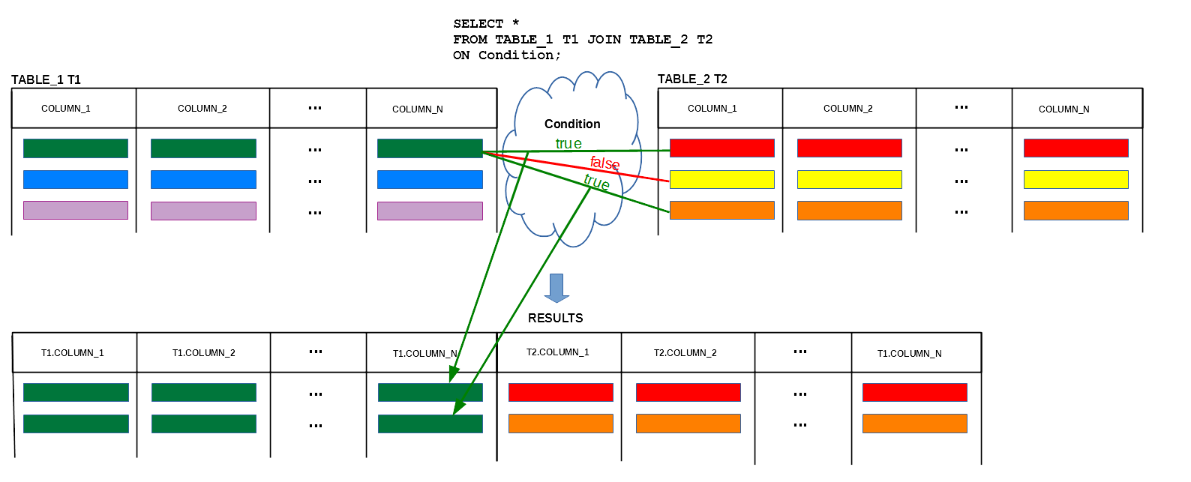
Join queries
Join operation "connects" the rows from two relational table
3
Notes:
<!-- Neural, Brian, Male, British English. -->
<speak>
<break time="0.5s"/>
<prosody rate="90%">
Assume, that we would like to implement a query, whose search condition applies to the columns in one relational table, while the information we search for is stored in another relational table.
<break time="0.3s"/>
For example, we would like to retrieve the values from a column: column 1, in a relational table : TABLE 1, such that the values in column: column n in a relational table: TABLE 1 and in a column: column 1 in a relational table: TABLE 2 satisfy the given condition.
<break time="0.3s"/>
A query, that uses more than one relational table is commonly called: "join query".
<break time="0.3s"/>
Implementation of join query requires application of the join operation, that connects the rows from two or more relational tables.
<break time="0.3s"/>
A computational model of the join operation is the following.
<break time="0.3s"/>
We pick the first row from a relational table: TABLE 1, and we pick the first row from a relational table: TABLE 2.
<break time="0.3s"/>
Next, we evaluate a join condition over the rows read from the relational tables: TABLE 1 and TABLE 2.
<break time="0.3s"/>
If a join condition evaluates to be true, then we concatenate the rows into one row and we append it to the results of the join operation.
<break time="0.3s"/>
If a condition evaluates to be false then nothing is appended to the results of the join operation.
<break time="0.3s"/>
Next, we pick the second row from a relational table: TABLE 2.
<break time="0.3s"/>
Again, we evaluate a join condition on the first row from a relational table: TABLE 1 and the second row from a relational table: TABLE 2.
<break time="0.3s"/>
If a join condition evaluates to be true then we concatenate the rows into one row and we append it to the results of the join operation.
<break time="0.3s"/>
Otherwise, we append nothing to the results of the join operation and we pick the third row from a relational table: TABLE 2.
<break time="0.3s"/>
Again, we evaluate a join condition on the first row from a relational table: TABLE 1 and the third row from a relational table: TABLE 2.
<break time="0.3s"/>
If a join condition evaluates to true, then we concatenate the rows into one row and we append it to the results of join operation.
<break time="0.3s"/>
Otherwise, we append nothing to the results of the join operation and we pick the third row from a relational table: TABLE 2.
<break time="0.3s"/>
And so on and so on.
<break time="0.5s"/>
</prosody>
</speak>
Systems Analysis
3

Slide 4
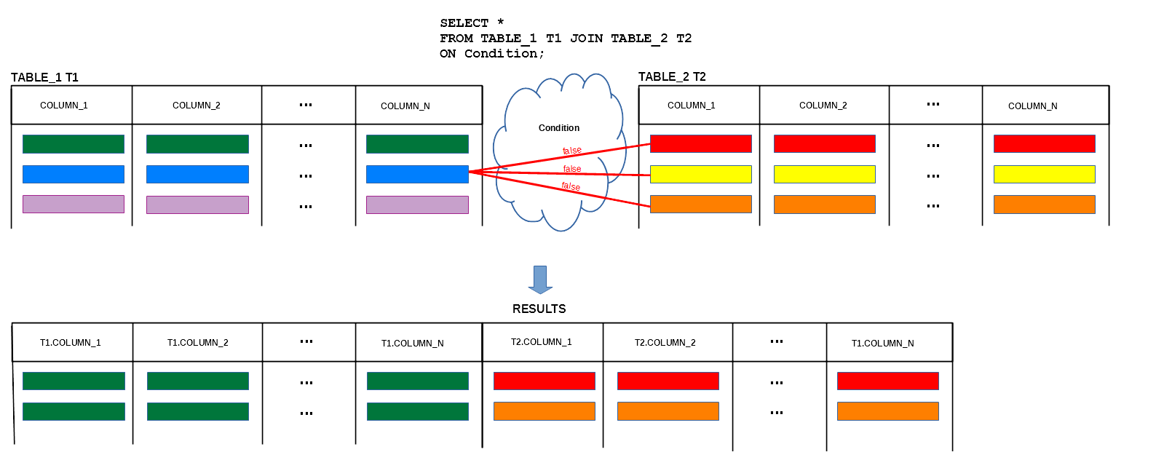
Join queries
Join operation "connects" the rows from two relational tables
4
Notes:
<!-- Neural, Brian, Male, British English. -->
<speak>
<break time="0.5s"/>
<prosody rate="90%">
When all rows from a relational table: TABLE 2, are used, we pick the second row from a relational table TABLE 1 and again the first row from a relational table: TABLE 2.
<break time="0.3s"/>
We evaluate a join condition on the second row from a relational table: TABLE 1 and the first row from a relational table: TABLE 2.
<break time="0.3s"/>
If a join condition evaluates to be true, then we concatenate the rows into one row and we append it to the results of the join operation.
<break time="0.3s"/>
Otherwise, we append nothing to the results of join operation and we pick the second row from a relational table: TABLE 2.
<break time="0.3s"/>
And so on and so on, until all rows from a relational table: TABLE 2 has been used for evaluation of a join condition with the second row from a relational table: TABLE 1.
<break time="0.5s"/>
</prosody>
</speak>
Systems Analysis
4

Slide 5
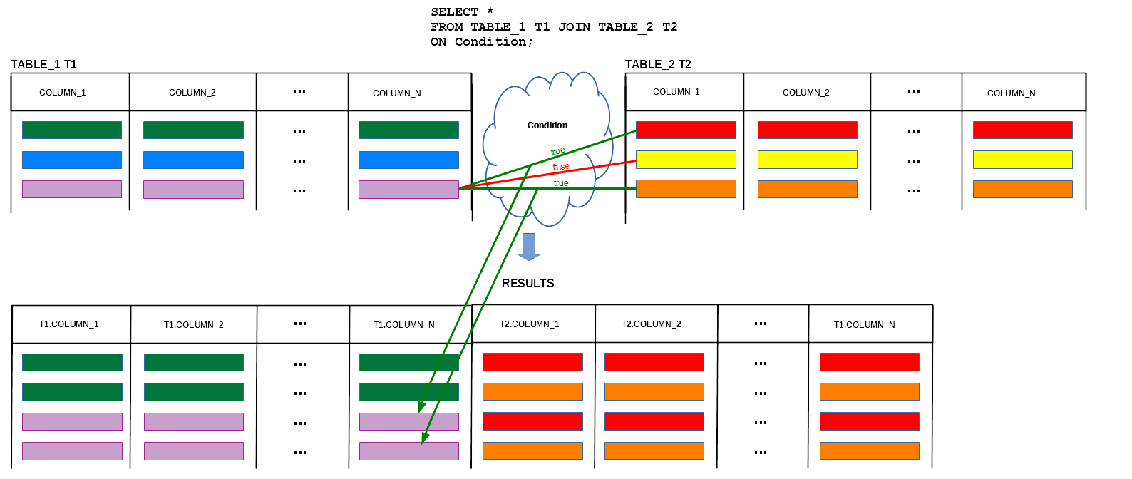
Join queries
Join operation "connects" the rows from two relational tables
5
Notes:
<!-- Neural, Brian, Male, British English. -->
<speak>
<break time="0.5s"/>
<prosody rate="90%">
When all rows from a relational table: TABLE 2, are used, we pick the third row from a relational table: TABLE 1 and again the first row from a relational table: TABLE 2.
<break time="0.3s"/>
We evaluate a join condition on the third row from a relational table: TABLE 1 and the first row from a relational table: TABLE 2.
<break time="0.3s"/>
If a join condition evaluates to be true, then we concatenate the rows into one row and we append it to the results of join operation.
<break time="0.3s"/>
Otherwise, we append nothing to the results of join operation and we pick the second row from a relational table: TABLE 2.
<break time="0.3s"/>
And so on and so on, until all rows from a relational table: TABLE 2, has been used for evaluation of a condition with the third row from a relational table: TABLE 1.
<break time="0.3s"/>
Then we pick the fourth row from a relational table: TABLE 1 and we again evaluate a join condition with all rows from a relational table: TABLE 2.
<break time="0.3s"/>
The join algorithm ends when all rows from a relational table: TABLE 1 are used for evaluation of a join condition with all rows from a relational table: TABLE 2.
<break time="0.3s"/>
Such algorithm is commonly called a "nested loop" algorithm because its implementation requires two iterations over the rows in the relational tables being joined.
<break time="0.3s"/>
One iteration over a relational table: TABLE 2 is nested within the other iteration over a relational table: TABLE 1.
<break time="0.3s"/>
When the relational tables are large, such algorithm is pretty poor from the performance point of view.
<break time="0.3s"/>
However, it is the simplest computational model that can be used to explain how the relational tables are joined.
<break time="0.5s"/>
</prosody>
</speak>
Systems Analysis
5

Slide 6
Join queries
Sample database
CREATE TABLE DEPARTMENT(
name VARCHAR(50) NOT NULL,
code CHAR(5) NOT NULL,
total_staff_number DECIMAL(2) NOT NULL,
chair VARCHAR(50) NULL,
budget DECIMAL(9,1) NOT NULL,
CONSTRAINT dept_pkey PRIMARY KEY(name),
CONSTRAINT dept_ckey1 UNIQUE(code),
CONSTRAINT dept_ckey2 UNIQUE(chair),
CONSTRAINT dept_check1 CHECK (total_staff_number BETWEEN 1 AND 50) );
CREATE TABLE COURSE(
cnum CHAR(7) NOT NULL,
title VARCHAR(200) NOT NULL,
credits DECIMAL(2) NOT NULL,
offered_by VARCHAR(50) NULL,
CONSTRAINT course_pkey PRIMARY KEY(cnum),
CONSTRAINT course_check1 CHECK (credits IN (6, 12)),
CONSTRAINT course_fkey1 FOREIGN KEY(offered_by)
REFERENCES DEPARTMENT(name) ON DELETE CASCADE );
6
Notes:
<!-- Neural, Brian, Male, British English. -->
<speak>
<break time="0.5s"/>
<prosody rate="90%">
We again use the same sample database, that contains information about the departments and about the courses offered by the departments.
<break time="0.3s"/>
The descriptions of departments are saved in a relational table: DEPARTMENT.
<break time="0.3s"/>
A description of department consists of: department name, department code, total staff number and budget.
<break time="0.3s"/>
A name of department uniquelly identifies each department.
<break time="0.3s"/>
A code of department also uniquelly identifies each department.
<break time="0.3s"/>
Total staff number per department cannot be greater than 50.
<break time="0.3s"/>
A description of course consists of: course number, title, credits and name of department that offers a course.
<break time="0.3s"/>
A course number is a unique identifier of each course.
<break time="0.3s"/>
The granted credits can be either 6 or 12.
<break time="0.5s"/>
</prosody>
</speak>
Systems Analysis
6

Slide 7
Join queries
Consider the following query: “find the titles of all courses offered by a department chaired by Peter”
DEPARTMENT
name | code | total_staff_number | chair | budget
- There are no titles of courses in a relational table DEPARTMENT !
- The titles of courses are in a relational table COURSE
COURSE
cnum | title | credits | offered_by
- To implement the query we must use two tables: DEPARTMENT and COURSE
- The rows from a table DEPARTMENT must be joined with (connected to) the respective rows in a relational table COURSE over a condition DEPARTMENT.name = COURSE.offered_by
SELECT COURSE.title
FROM COURSE JOIN DEPARTMENT
ON DEPARTMENT.name = COURSE.offered_by
WHERE DEPARTMENT.chair = 'Peter';
7
Notes:
<!-- Neural, Brian, Male, British English. -->
<speak>
<break time="0.5s"/>
<prosody rate="90%">
We start from few simple examples of queries, that require the applications of the join operation.
<break time="0.3s"/>
We consider the following query: "find the titles of all courses offered by a department chaired by Peter".
<break time="0.3s"/>
We look for the relational tables required to process the query.
<break time="0.3s"/>
We want to find a department chaired by Peter and to do so we need a relational table: DEPARTMENT.
<break time="0.3s"/>
Then we look for the titles of courses in a relational table: DEPARTMENT, and we find no information about the courses.
<break time="0.3s"/>
It means that we have to use another relational table: COURSE.
<break time="0.3s"/>
A relational table: COURSE, contains a column: title, with the titles of all courses.
<break time="0.3s"/>
We discover, that the rows from a relational table: DEPARTMENT, must be joined with the respective rows from a relational table: COURSE.
<break time="0.3s"/>
The next problem is a join condition.
<break time="0.3s"/>
What join condition must be used to connect the courses with the departments ?
<break time="0.3s"/>
Quite frequently, a join condition is an equality condition over a foreign key in one relational table and the respective primary key in another relational table.
<break time="0.3s"/>
In our case, it is an equality condition over the columns: name, in a relational table: DEPARTMENT, and: offered by, in a relational table: COURSE.
<break time="0.3s"/>
A join condition over a pair: a foreign key in one table and the respective primary key in the other table, is very common, because at conceptual level such search is equivalent to the traversal of an association from one class of the objects to another class of the objects.
<break time="0.3s"/>
It is one of the reasons, why we created the associations, at the conceptual modelling stage.
<break time="0.3s"/>
The association allows for joining smaller pieces of information located in different classes into larger ones.
<break time="0.3s"/>
Returning to our query, at the moment we have "all cards" to implement the query.
<break time="0.3s"/>
We use an operation: COURSE JOIN DEPARTMENT, in FROM clause and we follow it with a join condition: ON DEPARTMENT dot name equals COURSE dot offered by.
<break time="0.3s"/>
Finally, we add WHERE condition: DEPARTMENT dot chair equals Peter and we append SELECT clause that picks a column COURSE dot title from the results of join operation.
<break time="0.3s"/>
A complete SELECT statement is given at the bottom of the present slide.
<break time="0.5s"/>
</prosody>
</speak>
Systems Analysis
7

Slide 8
Join queries
Implementation of a query: “find the titles of all courses offered by a Department chaired by Peter” has the following syntactical variations
SELECT title
FROM COURSE JOIN DEPARTMENT
ON name = offered_by
WHERE chair = 'Peter';
SELECT C.title
FROM COURSE C JOIN DEPARTMENT D
ON D.name = C.offered_by
WHERE D.chair = 'Peter';
SELECT COURSE.title
FROM COURSE, DEPARTMENT
WHERE DEPARTMENT.name = COURSE.offered_by AND DEPARTMENT.chair = 'Peter';
SELECT title
FROM COURSE, DEPARTMENT
WHERE name = offered_by AND chair = 'Peter';
8
Notes:
<!-- Neural, Brian, Male, British English. -->
<speak>
<break time="0.5s"/>
<prosody rate="90%">
Implementation of a query: "find the titles of all courses offered by a department chaired by Peter", may have the following syntactical variations.
<break time="0.3s"/>
First, it is possible to remove the names of relational tables from a join condition, when the names of columns uniquely identify the columns in the relational tables being joined.
<break time="0.3s"/>
It means, that a relational table: COURSE, does not have a column: name and a relational table: DEPARTMENT, does not have a column: offered by.
<break time="0.3s"/>
The same rule applies to a condition included in WHERE clause.
<break time="0.3s"/>
A name: chair, uniquelly identifies a column in a relational table: DEPARTMENT, see the first SELECT statement in the present slide.
<break time="0.3s"/>
In the second example, we use the alias names instead of the names of relational tables in the SELECT, ON and WHERE clauses.
<break time="0.3s"/>
To create an alias name we follow name of a relational table in FROM clause with a blank and an alias name.
<break time="0.3s"/>
In the second SELECT statement a name of relational table: COURSE, is replaced with a name: C, and a name of a relational table DEPARTMENT, is replaced with a name D.
<break time="0.3s"/>
Later on, both alias names: C and D, are used in the remaining clauses of the SELECT statement.
<break time="0.3s"/>
Note, that when a relational table obtains an alias name, then the original name of the relational table cannot be used in the same SELECT statement anymore.
<break time="0.3s"/>
For example, we cannot use the names of the relational tables: DEPARTMENT and COURSE, together with the names of their alias names in the same SELECT statement.
<break time="0.3s"/>
In the third example we use an implicit join operation.
<break time="0.3s"/>
The relational tables to be joined are listed in FROM clause and the names of relational tables are separated with commas.
<break time="0.3s"/>
A join condition is appended to WHERE condition as a conjunction of WHERE condition and the join condition.
<break time="0.3s"/>
Finally, the fourth version of the same SELECT statement, is created from the previous one, by elimination of the names of relational tables prefixing the names of attributes.
<break time="0.5s"/>
</prosody>
</speak>
Systems Analysis
8

Slide 9
ANSI SQL Syntax
The following implementations of the query Find the titles of all courses offered by a department chaired by Peter are consistent with ANSI SQL standard
SELECT COURSE.title
FROM COURSE JOIN DEPARTMENT
ON DEPARTMENT.name = COURSE.offered_by
WHERE DEPARTMENT.chair = 'Peter';
SELECT title
FROM COURSE JOIN DEPARTMENT
ON name = offered_by
WHERE chair = 'Peter';
SELECT C.title
FROM COURSE C JOIN DEPARTMENT D
ON D.name = C.offered_by
WHERE D.chair = 'Peter';
9
Notes:
<!-- Neural, Brian, Male, British English. -->
<speak>
<break time="0.5s"/>
<prosody rate="90%">
Now, we present an implementation of the same query as before and consistent with ANSI S Q L standard.
<break time="0.3s"/>
ANSI S Q L standard, requires application of the JOIN operation in FROM clause and it must have ON clause with a join condition.
<break time="0.3s"/>
The first SELECT statement is the original statement, that implements the query.
<break time="0.3s"/>
It is a format of SELECT statement, that is strongly recommended by your lecturer, because compatibility with ANSI S Q L standard makes your code relevant to many different relational database systems.
<break time="0.3s"/>
It also provides all information, about the locations of the columns used in the SELECT and WHERE clauses of the relational tables.
<break time="0.3s"/>
The next two statements, are compatible with the ANSI S Q L standard as well.
<break time="0.3s"/>
The second SELECT statement, uses the uniqness of the column names in the relational tables to skip the names of relational tables.
<break time="0.3s"/>
The last SELECT statement, uses the aliases for the names of relational tables, to simplify both SELECT and WHERE clauses.
<break time="0.5s"/>
</prosody>
</speak>
Systems Analysis
9

Slide 10
Outline
Join queries
Natural join queries
Column name join queries
Cross join queries
Join queries over more than 2 relational tables
Self-join queries
10
Notes:
<!-- Neural, Brian, Male, British English. -->
<speak>
<break time="0.5s"/>
<prosody rate="90%">
Natural join queries.
<break time="0.3s"/>
</prosody>
</speak>
Systems Analysis
10

Slide 11
Natural join queries
Consider a query: Find the names of all employees from a Department chaired by James Bond over the relational tables:
DEPARTMENT
dname | code | total staff number | chair | budget
EMPLOYEE
enum | ename | dname
A natural join query
SELECT ename
FROM EMPLOYEE NATURAL JOIN DEPARTMENT
WHERE chair = 'James Bond';
is equivalent to a join query
SELECT ename
FROM EMPLOYEE JOIN DEPARTMENT
ON EMPLOYEE.dname = DEPARTMENT.dname
WHERE chair = 'James Bond';
11
Notes:
<!-- Neural, Brian, Male, British English. -->
<speak>
<break time="0.5s"/>
<prosody rate="90%">
The NATURAL JOIN operation, is a special case of the JOIN operation.
<break time="0.3s"/>
A default join condition of the NATURAL JOIN is a conjunction of equality comparisons, over the columns with the same names in both relational tables.
<break time="0.3s"/>
Consider the relational tables: DEPARTMENT and EMPLOYEE.
<break time="0.3s"/>
Assume, that both tables have a column with the same name: d name.
<break time="0.3s"/>
Next, consider a query: "find the names of all employees from a department chaired by James Bond".
<break time="0.3s"/>
The query can be implemented as SELECT statement with the operation of the NATURAL JOIN.
<break time="0.3s"/>
A default join condition is the following: DEPARTMENT dot d name equals EMPLOYEE dot d name.
<break time="0.3s"/>
The results of the JOIN operation have only one column d name.
<break time="0.3s"/>
This is because a join condition is an equality condition on the columns with the same names in both relational tables.
<break time="0.3s"/>
Then, the values in such columns in the results of the JOIN operation must be the same and there is no need to replicate a column: d name, twice.
<break time="0.3s"/>
A sample implementation of SELECT statement with the operation of the NATURAL JOIN, is given in the middle of the present slide.
<break time="0.3s"/>
An equivalent implementation, that uses the JOIN operation is given at the bottom of the present slide.
<break time="0.5s"/>
</prosody>
</speak>
Systems Analysis
11

Slide 12
Outline
Join queries
Natural join queries
Column name join queries
Cross join queries
Join queries over more than 2 relational tables
Self-join queries
12
Notes:
<!-- Neural, Brian, Male, British English. -->
<speak>
<break time="0.5s"/>
<prosody rate="90%">
Column name join queries.
<break time="0.5s"/>
</prosody>
</speak>
Systems Analysis
12

Slide 13
Column name join queries
Consider a query: Find the names of all employees from a Department chaired by James Bond over the relational tables
DEPARTMENT
dname | code | total staff number | chair | budget
EMPLOYEE
enum | ename | dname
A column name join query
SELECT ename
FROM EMPLOYEE JOIN DEPARTMENT
USING(dname)
WHERE chair = 'James Bond';
is equivalent to a join query
SELECT ename
FROM EMPLOYEE JOIN DEPARTMENT
ON EMPLOYEE.dname = DEPARTMENT.dname
WHERE chair = 'James Bond';
13
Notes:
<!-- Neural, Brian, Male, British English. -->
<speak>
<break time="0.5s"/>
<prosody rate="90%">
The operation of COLUMN JOIN is a special case of the JOIN operation.
<break time="0.3s"/>
A default join condition of COLUMN JOIN is a conjunction of the equality comparisons over the columns listed in the USING clause of the operation.
<break time="0.3s"/>
The names of columns listed in the USING clause must be included in both headers of the relational tables being joined.
<break time="0.3s"/>
Consider the relational tables: DEPARTMENT and EMPLOYEE.
<break time="0.3s"/>
Assume, that both tables have a column with the same name: d name.
<break time="0.3s"/>
Next, consider a query: "find the names of all employees from a department chaired by James Bond".
<break time="0.3s"/>
The query can be implemented as SELECT statement with the COLUMN JOIN operation.
<break time="0.3s"/>
The USING clause attached to the JOIN operation includes a name of a column: d name, to indicate a join condition, that is applied to join the rows from the relational tables.
<break time="0.3s"/>
Then, a default join condition is: DEPARTMENT dot d name equals EMPLOYEE dot d name
<break time="0.3s"/>
The results of the JOIN operation have only one column: d name.
<break time="0.3s"/>
This is because, the join condition is an equality condition on the columns with the same names listed in USING clause.
<break time="0.3s"/>
Then, the values in such columns must be the same as in the results of the COLUMN JOIN operation and there is no need to replicate a column d name twice.
<break time="0.3s"/>
A sample implementation of SELECT statement with the operation COLUMN JOIN, is given in the middle of the present slide.
<break time="0.3s"/>
An equivalent implementation with the JOIN operation is given at the bottom of the present slide.
<break time="0.5s"/>
</prosody>
</speak>
Systems Analysis
13

Slide 14
Outline
Join queries
Natural join queries
Column name join queries
Cross join queries
Join queries over more than 2 relational tables
Self-join queries
14
Notes:
<!-- Neural, Brian, Male, British English. -->
<speak>
<break time="0.5s"/>
<prosody rate="90%">
Cross join queries.
<break time="0.5s"/>
</prosody>
</speak>
Systems Analysis
14

Slide 15
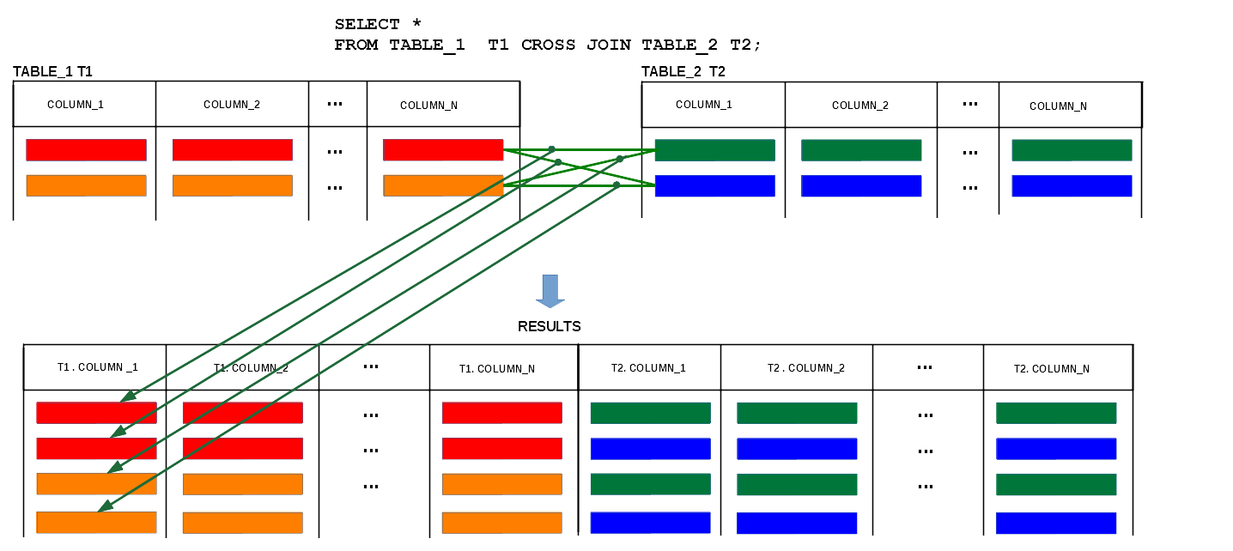
Cross join queries
Cross join operation "connects" all rows from relational table with all rows from another relational table
15
Notes:
<!-- Neural, Brian, Male, British English. -->
<speak>
<break time="0.5s"/>
<prosody rate="90%">
Assume, that we would like to join all rows from one relational table, with all rows from the other relational table.
<break time="0.3s"/>
You may ask why would we need to do something like that ?
<break time="0.3s"/>
For example, you may wish to enforce a logical consistency constraint, on the combinations of pairs of values from two different columns.
<break time="0.3s"/>
It can be done by creating a separate table with two columns, that contain the permitted pairs of values.
<break time="0.3s"/>
When a lot of pairs of values is permitted and only few are forbidden, then it is easier, to create all possible pairs and to remove the pairs that are forbidden.
<break time="0.3s"/>
In another example, we would like to implement a query, that finds the departments that offer all courses.
<break time="0.3s"/>
Then, to implement such query we join all departments with all courses and we remove from the result information about the departments that offer courses now.
<break time="0.3s"/>
All departments, that disappear from the results offer all courses.
<break time="0.3s"/>
The CROSS JOIN operation "joins" all rows from one relational table, with all rows from another relational table.
<break time="0.3s"/>
For example assume, that a relational table: TABLE 1, contains one red row and one orange row and a relational table:TABLE 2, contains one green row and one blue row.
<break time="0.3s"/>
Then, the CROSS JOIN operation creates a new relational table that contains four rows: red-green, red-blue, orange-green and orange-blue.
<break time="0.3s"/>
It means, all combinations of rows from the relational tables: TABLE 1 and TABLE 2.
<break time="0.5s"/>
</prosody>
</speak>
Systems Analysis
15

Slide 16
Cross join queries
Consider a query: Find all pairs of names of employees and names of chair people”
DEPARTMENT
dname | code | total staff number | chair | budget
EMPLOYEE
enum | ename | dname
A cross join query
SELECT ename, chair
FROM EMPLOYEE CROSS JOIN DEPARTMENT;
is equivalent to the following join queries
SELECT ename, chair
FROM EMPLOYEE JOIN DEPARTMENT;
SELECT ename, chair
FROM EMPLOYEE, DEPARTMENT;
16
Notes:
<!-- Neural, Brian, Male, British English. -->
<speak>
<break time="0.5s"/>
<prosody rate="90%">
Consider the relational tables: DEPARTMENT and EMPLOYEE.
<break time="0.3s"/>
A query: "find all pairs of names of employees and names of chair people" can be implemented with the CROSS JOIN operation on the relational tables: EMPLOYEE and DEPARTMENT.
<break time="0.3s"/>
The first SELECT statement, in the present slide contains implementation of the query with the CROSS JOIN operation.
<break time="0.3s"/>
The results of CROSS JOIN operation are the same as the results of a query with JOIN operation, that has missing join condition in ON clause.
<break time="0.3s"/>
Also a query, that lists two or more relational tables in FROM clause and it does not have a join condition in WHERE clause, can be used to compute the CROSS JOIN operation.
<break time="0.3s"/>
It is recommended, to explicitly use the CROSS JOIN operation in FROM clause, because in such a case, there are no doubts, that we really would like to compute the CROSS JOIN and it is not an accidental outcome of missing or incorrect ON clause or missing or incorrect join condition in WHERE clause.
<break time="0.3s"/>
Note, that if both relational tables contain 1000 rows, then the result of the CROSS JOIN will contain 1000 multiplied by 1000 rows, it means 1000000 rows.
<break time="0.5s"/>
</prosody>
</speak>
Systems Analysis
16

Slide 17
Outline
Join queries
Natural join queries
Column name join queries
Cross join queries
Join queries over more than 2 relational tables
Self-join queries
17
Notes:
<!-- Neural, Brian, Male, British English. -->
<speak>
<break time="0.5s"/>
<prosody rate="90%">
Join queries over more than 2 relational tables.
<break time="0.5s"/>
</prosody>
</speak>
Systems Analysis
17

Slide 18
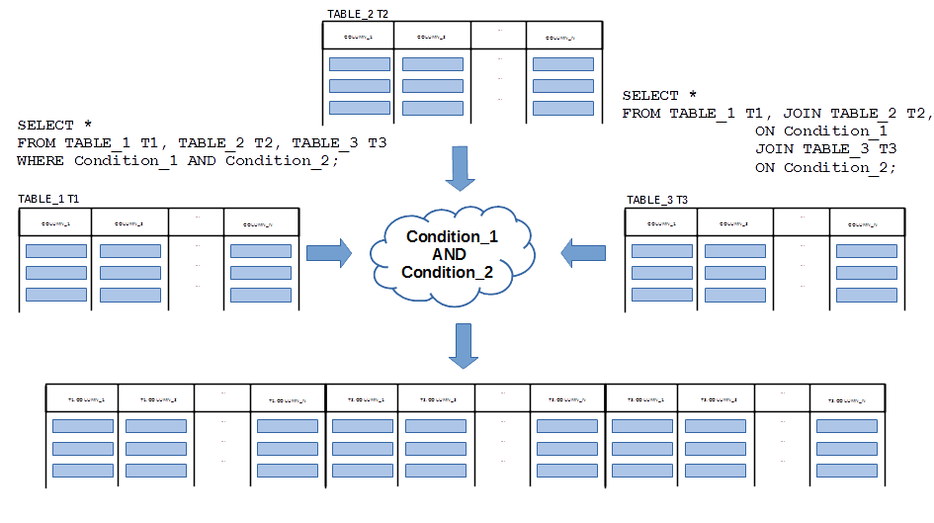
Join queries over more than 2 tables
A sample join of three relational tables TABLE_1, TABLE_2, and TABLE_3
18
Notes:
<!-- Neural, Brian, Male, British English. -->
<speak>
<break time="0.5s"/>
<prosody rate="90%">
Assume, that we would like to join three relational tables: TABLE 1, TABLE 2 and TABLE 3.
<break time="0.3s"/>
To make things a bit easier, we create the alias names for the tables: T 1, T 2 and T 3.
<break time="0.3s"/>
Assume, that the relational tables: T 1 and T 2, must be joined over a join condition: Condition 1.
<break time="0.3s"/>
Then, the results of the first join must be joined with the relational table: T 3, over a condition Condition 2.
<break time="0.3s"/>
The first join is expressed in a usual way with the JOIN operation in FROM clause and with ON clause and a join condition: Condition 1.
<break time="0.3s"/>
Please, see the first three lines of SELECT statement on the right hand side of the present slide.
<break time="0.3s"/>
Next, to join the results of the first JOIN with a relational table: T 3, we append the next JOIN operation with a name of a relational table T 3.
<break time="0.3s"/>
Then, we append the next join condition to join T3 with the results of the earlier join of T 1 and T 2.
<break time="0.3s"/>
It is possible to express the same sequence of operations by listing the names of relational tables to be joined in: FROM clause, and by adding a conjunction of join conditions: Condition 1 and Condition 2, to WHERE clause.
<break time="0.3s"/>
Please, see SELECT statement on the left hand side of the present slide.
<break time="0.3s"/>
Join of three relational tables, is a single relational table that consists of all columns from the joined relational tables and all rows created from the triples of the rows from: T 1, T 2 and T 3 such that each triple satisfies both conditions: Condition 1 and Condition 2.
<break time="0.5s"/>
</prosody>
</speak>
Systems Analysis
18

Slide 19
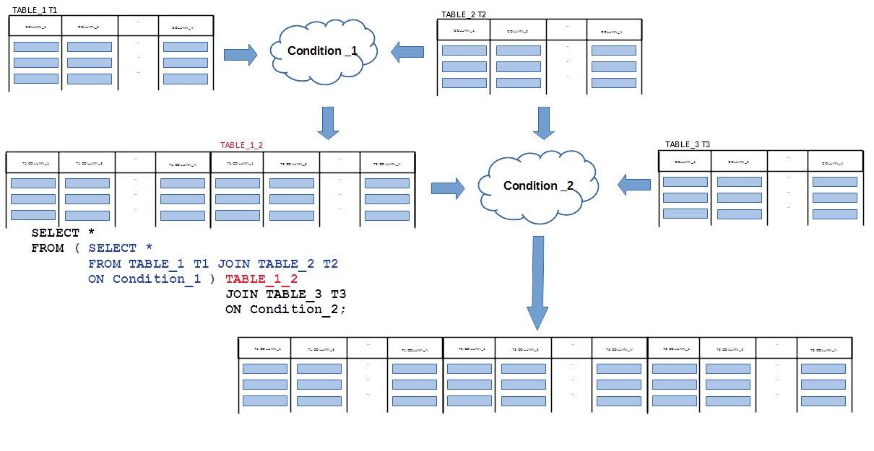
Join queries over more than 2 tables
Application of inline view to simplify join of three relational tables TABLE_1, TABLE_2, and TABLE_3
19
Notes:
<!-- Neural, Brian, Male, British English. -->
<speak>
<break time="0.5s"/>
<prosody rate="90%">
It is still possible to implement join of three or more relational tables, as a sequence of joins over two tables and inline views.
<break time="0.3s"/>
An idea is to join two relational tables first, and save a temporary result of join as an inline view.
<break time="0.3s"/>
And then, join a temporary inline view with the third relational table.
<break time="0.3s"/>
The present slide visualises a process of joining multiple relational tables, through creation of the intermediate inline views.
<break time="0.3s"/>
We first join the relational tables: TABLE 1 and TABLE 2.
<break time="0.3s"/>
The results of the join becomes a temporary inline view, that obtaines a name: TABLE 1 2.
<break time="0.3s"/>
SELECT statement, that joins the relational tables: TABLE 1 and TABLE 2 is enclosed within parenthesis and it is followed by a name TABLE 1 2.
<break time="0.3s"/>
Then, a definition of a temporary inline view is placed in FROM clause and it is followed by the JOIN operation with TABLE 3.
<break time="0.3s"/>
A complete SELECT statement, is given in the left lower corner of the present slide.
<break time="0.5s"/>
</prosody>
</speak>
Systems Analysis
19

Slide 20
Join queries over more than 2 tables
Consider the relational tables with the following schemas
COURSE
cnum | title | credits
STUDENT
snum | name | degree
ENROLMENT
cnum | snum | edate | result
A query find the names of all students who enrolled Java course can be implemented as the following join query
SELECT STUDENT.name
FROM COURSE JOIN ENROLMENT
ON COURSE.cnum = ENROLMENT.cnum
JOIN STUDENT
ON ENROLMENT.snum = STUDENT.snum
WHERE COURSE.title = 'Java';
20
Notes:
<!-- Neural, Brian, Male, British English. -->
<speak>
<break time="0.5s"/>
<prosody rate="90%">
To practice the JOIN operation on many relational tables, we consider the following example.
<break time="0.3s"/>
A relational table: COURSE, contains information about the courses described by a course number ( a column c num), course title ( a column title) and credits.
<break time="0.3s"/>
A relational table: STUDENT, contains information about the students and it consists of the columns: student number, (column s num), full name (column name) and degree enrolled by each student.
<break time="0.3s"/>
A relational table: ENROLMENT, contains information about the enrolments performed by the students.
<break time="0.3s"/>
The table consists of the columns: course number ( column c num), student number (column s num), enrolment date (column e date) and the final result scored by each student (column: result).
<break time="0.3s"/>
We would like to implement a query: "find the names of all students who enrolled a Java course".
<break time="0.3s"/>
To find a Java course, we need to access a column: title, in a relational table: COURSE.
<break time="0.3s"/>
To find the names of students, we need to access a column: name, in a relational table: STUDENT.
<break time="0.3s"/>
To join information about the courses, with information about the students, we must use information about the courses enrolled by the students.
<break time="0.3s"/>
It means that we must use a relational table: ENROLMENT.
<break time="0.3s"/>
To join information about the courses, with information about the enrolments, we create a join condition: COURSE dot c num equals to ENROLMENT dot c num.
<break time="0.3s"/>
To join information about the students, with information about the enrolments we create a join condition: STUDENT dot s num equals ENROLMENT dot s num.
<break time="0.3s"/>
Now, we can create SELECT statement that joins the relational tables: COURSE, ENROLMENT and STUDENT.
<break time="0.3s"/>
First, we join in FROM clause the relational tables: COURSE and ENROLEMENT, over a join condition: COURSE dot c num equals to ENROLMENT dot c num.
<break time="0.3s"/>
Next, the result is joined with a relational table: STUDENT, over a join condition: STUDENT dot s num equal ENROLMENT dot s num.
<break time="0.3s"/>
Finally, WHERE clause filters the rows where a title of a course is: Java.
<break time="0.3s"/>
A complete SELECT statement, that joins three relational tables, is given at the bottom of the present slide,
<break time="0.5s"/>
</prosody>
</speak>
Systems Analysis
20

Slide 21
Join queries over more than 2 tables
Implementation of a query “find the names of all students who enrolled Java course has the following syntactical variations”
SELECT STUDENT.name
FROM COURSE JOIN ENROLMENT
ON COURSE.cnum = ENROLMENT.cnum
JOIN STUDENT
ON ENROLMENT.snum = STUDENT.snum
WHERE COURSE.title = 'Java’;
SELECT STUDENT.name
FROM COURSE, ENROLMENT, STUDENT
WHERE COURSE.cnum = ENROLMENT.cnum AND ENROLMENT.snum = STUDENT.snum AND
COURSE.title = 'Java’;
SELECT STUDENT.name
FROM ( SELECT *
FROM COURSE JOIN ENROLMENT
ON COURSE.cnum = ENROLMENT.cnum
WHERE COURSE.title = 'Java' ) CE JOIN STUDENT
ON CE.snum = STUDENT.snum
WHERE COURSE.title = 'Java';
21
Notes:
<!-- Neural, Brian, Male, British English. -->
<speak>
<break time="0.5s"/>
<prosody rate="90%">
The present slide, shows three different implementations of a query: "find the names of all students who enrolled a Java course".
<break time="0.3s"/>
The first SELECT statement uses ANSI S Q L standard of the JOIN operation.
<break time="0.3s"/>
The second SELECT statement, lists all relational tables involved in the JOIN operation in the FROM clause and, it lists all join condition as the Boolean expression in the WHERE clause.
<break time="0.3s"/>
In such case we expect, that a query processor will be able to correctly extract, a join condition from a conjunction of elementary conditions in WHERE clause.
<break time="0.3s"/>
The third SELECT statement, uses a technique of inline views, to first join a relational table: COURSE, with a relational table: ENROLMENT and to create a temporary inline view: C E.
<break time="0.3s"/>
Then, a temporary inline view: C E, is joined with a relational table: STUDENT.
<break time="0.5s"/>
</prosody>
</speak>
Systems Analysis
21

Slide 22
Outline
Join queries
Natural join queries
Column name join queries
Cross join queries
Join queries over more than 2 relational tables
Self-join queries
22
Notes:
<!-- Neural, Brian, Male, British English. -->
<speak>
<break time="0.5s"/>
<prosody rate="90%">
Self-join queries.
<break time="0.5s"/>
</prosody>
</speak>
Systems Analysis
22

Slide 23
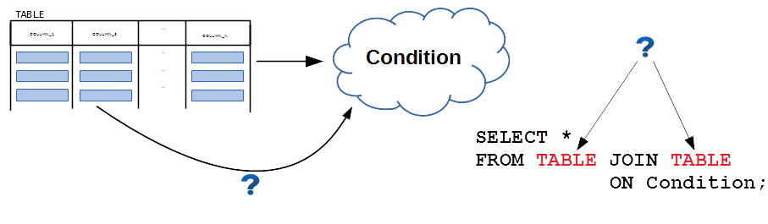
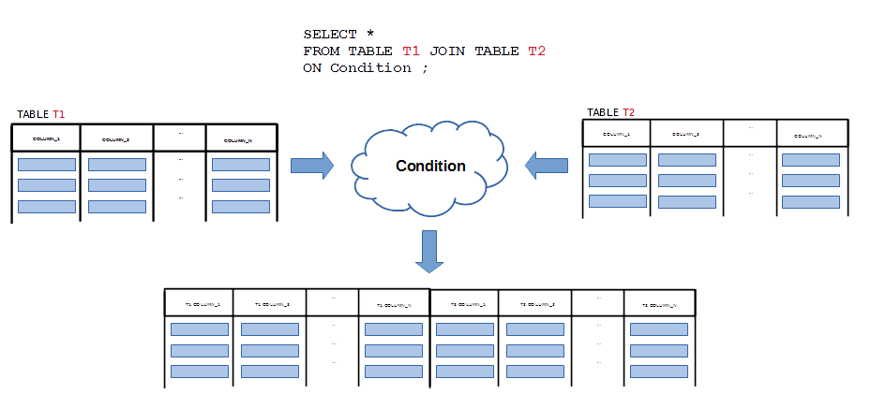
Self-join queries
What if a relational table must be joined with itself ?
A table that must be joined with itself obtains two different alias names
23
Notes:
<!-- Neural, Brian, Male, British English. -->
<speak>
<break time="0.5s"/>
<prosody rate="90%">
<break time="0.3s"/>
Implementation of certain queries may require a join of a relational table with itself.
<break time="0.3s"/>
It happens, when a relational table implements one to many association, that links the same class of objects on its left and right hand side.
<break time="0.3s"/>
For example, an association: EMPLOYEE Is manager of EMPLOYEE, is a typical example of one to many association, that have the same class of objects at both of its ends.
<break time="0.3s"/>
Then, the logical design transforms such association into a single relational table, that has a foreign key referencing the primary key, in the same relational table.
<break time="0.3s"/>
For example, a column: manager number, references the primary key: employee number, in a relational table: EMPLOYEE.
<break time="0.3s"/>
Then, navigation over an association: Is Manager of, is equivalent in a relational implementation to a join of a relational table: EMPLOYEE, with itself.
<break time="0.3s"/>
How to join a relational table with itself, when it is not possible to list in FROM clause, two identical names of the relational tables ?
<break time="0.3s"/>
To solve the problem, we give two alias names to the same relational table.
<break time="0.3s"/>
Then, we imagine ourselves, that we operate on two relational tables, that have the different names and, that have the same columns and the same contents.
<break time="0.3s"/>
A sample SELECT statement, that creates two alias names: T 1 and T 2, for a relational table: TABLE, is given in the middle of the slide.
<break time="0.5s"/>
</prosody>
</speak>
Systems Analysis
23

Slide 24
Self-join queries
Consider a relational table with the following schema
EMPLOYEE
enum, name, manager
and the following contents
+------+-------+---------+
| enum | name | manager |
+------+-------+---------+
| 10 | John | NULL |
| 20 | Peter | 10 |
| 30 | Mary | 10 |
| 40 | Mike | 20 |
| 50 | Kate | 20 |
| 60 | Greg | 50 |
| 70 | Phil | 50 |
+------+-------+---------+
Consider a query find a name of manager of employee number 40
We can "plan" the implementation in the following way
(1) Find an employee number of manager of employee number 40
(2) Find a name of employee found in the previous query
24
Notes:
<!-- Neural, Brian, Male, British English. -->
<speak>
<break time="0.5s"/>
<prosody rate="90%">
Consider a relational table: EMPLOYEE, that contains information about the employees and their managers.
<break time="0.3s"/>
A relational table: EMPLOYEE, consists of the columns e num (employee number), name ( employee name) and manager ( employee number of a manager )
<break time="0.3s"/>
The sample contents of a relational table: EMPLOYEE, is given in the middle of the present slide.
<break time="0.3s"/>
An employee: John, has the employee number 10 and he does not have an employee number of his manager.
<break time="0.3s"/>
It means, that John is the topmost manager.
<break time="0.3s"/>
An employee: Peter, has the employee number 20 and his manager is an employee, that has the number 10, John.
<break time="0.3s"/>
An employee: Mary, has the employee number 30 and her manager is also an employee, that has the number 10, John.
<break time="0.3s"/>
An employee: Mike, has the employee number 40 and his manager is an employee, that has the number 20, Peter.
<break time="0.3s"/>
In the same way we can find the managers of the employees number 50, 60 and 70.
<break time="0.3s"/>
Assume, that we would like to implement a query: "find a name of manager of employee number 40".
<break time="0.3s"/>
We can "plan" the implementation in the following way.
<break time="0.3s"/>
First, we find the employee number of a manager of employee number 40.
<break time="0.3s"/>
Then, we find a name of the employee found in the previous query.
<break time="0.5s"/>
</prosody>
</speak>
Systems Analysis
24

Slide 25
Self-join queries
Implementation of a plan
(1) Find employee number of manager of employee number 40
(2) Find a name of employee found in the previous query
is the following
SELECT manager
FROM EMPLOYEE
WHERE enum = 40;
20
SELECT name
FROM EMPLOYEE
WHERE enum = 20;
Peter
Is it possible to implement the query as one SELECT statement ?
YES ! In more than one way !
25
Notes:
<!-- Neural, Brian, Male, British English. -->
<speak>
<break time="0.5s"/>
<prosody rate="90%">
Implementation of a plan explained in the previous slide is the following.
<break time="0.3s"/>
The first SELECT statement implements a query: "find an employee number of a manager of employee number 40".
<break time="0.3s"/>
The result of such SELECT statement is: 20.
<break time="0.3s"/>
The second SELECT statement implements a query: "Find a name of employee who has a number found in the previous query".
<break time="0.3s"/>
The result of such SELECT statement is: Peter.
<break time="0.3s"/>
Both SELECT statements are listed in the middle of the present slide.
<break time="0.3s"/>
Is it possible to implement the query as one SELECT statement ?
<break time="0.3s"/>
Yes, it is possible to do it in more than one way !
<break time="0.5s"/>
</prosody>
</speak>
Systems Analysis
25

Slide 26
Self-join queries
Solution 1
Assume that we have two identical relational tables E1 and E2
E1 E2
+------+-------+---------+ +------+-------+---------+
| enum | name | manager | | enum | name | manager |
+------+-------+---------+ +------+-------+---------+
| 10 | John | NULL | | 10 | John | NULL |
| 20 | Peter | 10 | -------->| 20 | Peter | 10 |
| 30 | Mary | 10 | | | 30 | Mary | 10 |
| 40 | Mike | 20 |----- | 40 | Mike | 20 |
| 50 | Kate | 20 | | 50 | Kate | 20 |
| 60 | Greg | 50 | | 60 | Greg | 50 |
| 70 | Phil | 50 | | 70 | Phil | 50 |
+------+-------+---------+ +------+-------+---------+
To find a name of manager of employee number 40 we take a row
| 40 | Mike | 20 |
from a table E1 and we join over a condition E1.manager = E2.enum with a row
| 20 | Peter | 10 |
from a table E2
26
Notes:
<!-- Neural, Brian, Male, British English. -->
<speak>
<break time="0.5s"/>
<prosody rate="90%">
So, how do we implement such "magic" as a SELECT statement ?
<break time="0.3s"/>
First, we implement FROM clause, that contains the JOIN operation of two aliases: E 1 and E 2, of a relational table EMPLOYEE.
<break time="0.3s"/>
Then, we append to ON clause, a join condition: E 1 dot manager equals E 2 dot e num, found in the present slide.
<break time="0.3s"/>
Next, we set the initial condition: E 1 dot e num equals 40 in WHERE clause.
<break time="0.3s"/>
Finally, we use: E 2 dot name in SELECT clause to find a name of a manager.
<break time="0.3s"/>
A solution is listed at the top of the present slide.
<break time="0.3s"/>
A relational table: E 1, is used in the query to find an employee number of Peter's manager.
<break time="0.3s"/>
A relational table: E 2, is used in the query to find a name of Peter's manager.
<break time="0.5s"/>
</prosody>
</speak>
Systems Analysis
26

Slide 27
Self-join queries
So, how do we implement such "magic" ?
SELECT E2.name
FROM EMPLOYEE E1 JOIN EMPLOYEE E2
ON E1.manager = E2.enum
WHERE E1.enum = 40;
E1 E2
+------+-------+---------+ +------+-------+---------+
| enum | name | manager | | enum | name | manager |
+------+-------+---------+ +------+-------+---------+
| 10 | John | NULL | | 10 | John | NULL |
| 20 | Peter | 10 | -------->| 20 | Peter | 10 |
| 30 | Mary | 10 | | | 30 | Mary | 10 |
| 40 | Mike | 20 |----- | 40 | Mike | 20 |
| 50 | Kate | 20 | | 50 | Kate | 20 |
| 60 | Greg | 50 | | 60 | Greg | 50 |
| 70 | Phil | 50 | | 70 | Phil | 50 |
+------+-------+---------+ +------+-------+---------+
27
Notes:
<!-- Neural, Brian, Male, British English. -->
<speak>
<break time="0.5s"/>
<prosody rate="90%">
So, how do we implement such "magic" as SELECT statement ?
<break time="0.3s"/>
First, we implement FROM clause, that contains the JOIN operation of two aliases: E 1 and E 2, of a relational table EMPLOYEE.
<break time="0.3s"/>
Then, we append to ON clause, a join condition: E 1 dot manager = E 2 dot e num, found in the previous slide.
<break time="0.3s"/>
Next, we set the initial condition: E 1 dot e num equals 40 in WHERE clause.
<break time="0.3s"/>
Finally, we use: E 2 dot name in SELECT clause to find a name of a manager.
<break time="0.3s"/>
A solution is listed at the top of the present slide.
<break time="0.3s"/>
A relational table: E 1, is used in the query to find an employee number of Peter's manager.
<break time="0.3s"/>
A relational table: E 2, is used in the query to find a name of Peter's manager.
<break time="0.5s"/>
</prosody>
</speak>
Systems Analysis
27

Slide 28
Self-join queries
Solution 2
We use inline views technique to combine the following queries
SELECT manager
FROM EMPLOYEE
WHERE enum = 40;
SELECT name
FROM EMPLOYEE
WHERE enum = 20;
We use the first SELECT statement to create an inline view E40
( SELECT manager
FROM EMPLOYEE
WHERE enum = 40 ) E40
Then we join an inline view E40 with a relational table EMPLOYEE
SELECT EMPLOYEE.name
FROM EMPLOYEE JOIN ( SELECT manager
FROM EMPLOYEE
WHERE enum = 40 ) E40
ON EMPLOYEE.enum = E40.manager;
28
Notes:
<!-- Neural, Brian, Male, British English. -->
<speak>
<break time="0.5s"/>
<prosody rate="90%">
In the second solution, we use a technique of inline views to combine the queries, that join a relational table with itself.
<break time="0.3s"/>
The first SELECT statement, that finds a manager of employee number 40, is used to create an inline view E 40.
<break time="0.3s"/>
Then, an inline view E 40 is joined with a relational table EMPLOYEE.
<break time="0.3s"/>
A complete SELECT statement is given at the bottom of the present slide.
<break time="0.5s"/>
</prosody>
</speak>
Systems Analysis
28

Slide 29
Self-join queries
In another query we find the names of all employees directly managed by Kate
+------+-------+---------+
| enum | name | manager |
+------+-------+---------+
| 10 | John | NULL |
| 20 | Peter | 10 |
| 30 | Mary | 10 |
| 40 | Mike | 20 |
| 50 | Kate | 20 |
| 60 | Greg | 50 |
| 70 | Phil | 50 |
+------+-------+---------+
We "plan" the implementation in the following way
(1) Find an employee number of an employee Kate
(2) Find the names of employees who have a number found in the previous query in a column manager
29
Notes:
<!-- Neural, Brian, Male, British English. -->
<speak>
<break time="0.5s"/>
<prosody rate="90%">
In another example, we implement a query, that "finds the names of all employees directly managed by Kate".
<break time="0.3s"/>
We plan the implementation in the following way.
<break time="0.3s"/>
The first SELECT statement, "finds an employee number of an employee Kate".
<break time="0.3s"/>
The second SELECT statement, "finds the names of employees whose manager has the employee number found in the previous query".
<break time="0.5s"/>
</prosody>
</speak>
Systems Analysis
29

Slide 30
Self-join queries
Solution 1
Assume that we have two identical relational tables E1 and E2
E1 E2
+------+-------+---------+ +------+-------+---------+
| enum | name | manager | | enum | name | manager |
+------+-------+---------+ +------+-------+---------+
| 10 | John | NULL | | 10 | John | NULL |
| 20 | Peter | 10 | | 20 | Peter | 10 |
| 30 | Mary | 10 | | 30 | Mary | 10 |
| 40 | Mike | 20 | | 40 | Mike | 20 |
| 50 | Kate | 20 | -------- | 50 | Kate | 20 |
| 60 | Greg | 50 |<---| | 60 | Greg | 50 |
| 70 | Phil | 50 |<---| | 70 | Phil | 50 |
+------+-------+---------+ +------+-------+---------+
To find a number of employee Kate we take a row
| 50 | Kate | 20 |
from a table E2 and we join it over a condition E2.enum = E1.manager with the rows
| 60 | Greg | 50 |
| 70 | Phil | 50 |
from a table E1
30
Notes:
<!-- Neural, Brian, Male, British English. -->
<speak>
<break time="0.5s"/>
<prosody rate="90%">
The first solution is the following.
<break time="0.3s"/>
Assume, that we have two identical relational tables: E 1 and E 2
<break time="0.3s"/>
The relational tables: E 1 and E 2 are visualised in the present slide.
<break time="0.3s"/>
To find a number of employee Kate, we select a row: 50, Kate, 20, from a relational table E 2.
<break time="0.3s"/>
Next, we join the row over a condition: E 2 dot e num = E 1 dot manager with the rows from a relational table E 1, that have a value 50 in a column: manager,
<break time="0.3s"/>
An arrow, linking a table E 2 with a table E 1 visualises a join condition.
<break time="0.5s"/>
</prosody>
</speak>
Systems Analysis
30

Slide 31
Self-join queries
So, how do we implement such "magic" ?
SELECT E1.name
FROM EMPLOYEE E1 JOIN EMPLOYEE E2
ON E1.manager = E2.enum
WHERE E2.name = 'Kate';
E1 E2
+------+-------+---------+ +------+-------+---------+
| enum | name | manager | | enum | name | manager |
+------+-------+---------+ +------+-------+---------+
| 10 | John | NULL | | 10 | John | NULL |
| 20 | Peter | 10 | | 20 | Peter | 10 |
| 30 | Mary | 10 | | 30 | Mary | 10 |
| 40 | Mike | 20 | | 40 | Mike | 20 |
| 50 | Kate | 20 | -------- | 50 | Kate | 20 |
| 60 | Greg | 50 |<---| | 60 | Greg | 50 |
| 70 | Phil | 50 |<---| | 70 | Phil | 50 |
+------+-------+---------+ +------+-------+---------+
31
Notes:
<!-- Neural, Brian, Male, British English. -->
<speak>
<break time="0.5s"/>
<prosody rate="90%">
So, how do we implement such "magic" as a SELECT statement ?
<break time="0.3s"/>
First, we implement FROM clause, that contains the JOIN operation of two aliases: E 1 and E 2, of a relational table: EMPLOYEE.
<break time="0.3s"/>
Then, we append to ON clause, a join condition: E 2 dot e num = E 1 dot manager, found in the previous slide.
<break time="0.3s"/>
Next, we set the initial condition: E 2 dot name equals Kate in WHERE clause.
<break time="0.3s"/>
Finally, we use: E 1 dot name in SELECT clause to find the names of employees.
<break time="0.3s"/>
A solution is listed at the top of the present slide.
<break time="0.3s"/>
A relational table: E 2, is used in the query to find the Kate's employee number.
<break time="0.3s"/>
A relational table: E 1, is used in the query to find the names of employees managed by Kate.
<break time="0.5s"/>
</prosody>
</speak>
Systems Analysis
31

Slide 32
Self-join queries
Solution 2
We use inline views technique to combine the following queries
SELECT enum
FROM EMPLOYEE
WHERE name = 'Kate';
SELECT name
FROM EMPLOYEE
WHERE manager = 50;
We use the first SELECT statement to create an inline view KATE
( SELECT enum
FROM EMPLOYEE
WHERE name = 'Kate' ) KATE
Then we join an inline view KATE with a relational table EMPLOYEE
SELECT EMPLOYEE.name
FROM EMPLOYEE JOIN ( SELECT enum
FROM EMPLOYEE
WHERE name = 'Kate' ) KATE
ON EMPLOYEE.manager = KATE.enum;
32
Notes:
<!-- Neural, Brian, Male, British English. -->
<speak>
<break time="0.5s"/>
<prosody rate="90%">
In the second solution, we use a technique of inline views to combine the queries, that join a relational table with itself.
<break time="0.3s"/>
The first SELECT statement, that finds Kate's employee number, is used to create an inline view: KATE.
<break time="0.3s"/>
Then, an inline view: KATE, is joined with a relational table: EMPLOYEE, to find the names of employees managed by Kate.
<break time="0.3s"/>
A complete SELECT statement is given at the bottom of the present slide.
<break time="0.5s"/>
</prosody>
</speak>
Systems Analysis
32

Slide 33
References
C. Coronel, S. Morris, A. Basta, M. Zgola, Data Management and Security, Chapters 5, 7, Cengage Compose eBook, 2018, eBook: Data Management and Security, 1st Edition
T. Connoly, C. Begg, Database Systems, A Practical Approach to Design, Implementation, and Management, Chapters 6.3.7 Multi-table Queries, Pearson Education Ltd, 2015
D. Darmawikarta, SQL for MySQL A Beginner’s Tutorial, Chapter 6, pages 55 - 61 Brainy Software Inc. First Edition: June 2014
How to ... ? Cookbook, How to implement queries in SQL ? (Part 1), Recipe 5.4 How to implement simple join queries ?
How to ... ? Cookbook, How to implement queries in SQL ? (Part 2) Recipe 6.1 How to implement self join queries ?
33
Notes:
<!-- Neural, Brian, Male, British English. -->
<speak>
<break time="0.5s"/>
<prosody rate="90%">
References.
<break time="0.5s"/>
</prosody>
</speak>
Systems Analysis
33

